Slide 1
Rhetorical Appeals
The ways that writers/speakers/photographers get readers’ attention…

Slide 2
Rhetorical appeals
The aspects of a piece of writing or a visual that influence the reader because of:
The credibility of the author (ethos)
The appeal to a reader’s logic (logos)
An appeal to the reader’s emotions (pathos)
Rhetorical Appeals are the main tools of persuasion.

Slide 3
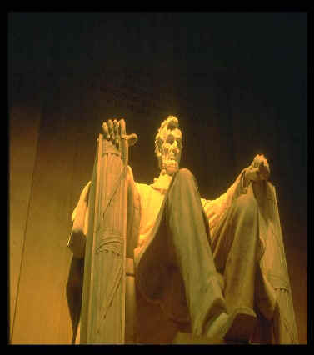
Ethos works by establishing credibility with the audience.
“You should believe me because I’m trustworthy.”
--Honest Abe
Ethos or Ethical appeals:

Slide 4
Ethos
Ethos is an ethic appeal
It attempts to convince the audience by the character of the author. We tend to believe people whom we respect.
One of the central problems of argumentation is to project an impression to the reader that you are someone worth listening to, in other words making yourself as author into an authority on the subject of the paper, as well as someone who is likable and worthy of respect.
This can be done by:
Demonstrating a level of expertise (well researched papers)
Being an expert (Doctor, Lawyer, Actor etc.)
Avoiding excessive emotion & being likeable

Slide 5
Ethos Analysis Questions
What implicit or explicit claim is being made?
How does the ad show credibility and trustworthiness to the intended audience?
Does the ad reflect areas of expertise in some form or another? In what ways has this ad/product/author given the impression that we should listen to them?
In what way are we convinced ethically or by the character of the product?

Slide 6

Logical appeals work by appealing to the reason of your audience.
“You should agree with me because I’m reasonable.”
“You should listen to me because I have statistics.”
Logos or Logical Appeals

Slide 7
So – Logos…
Logos means persuading by the use of reasoning.
Using effective and persuasive reasons to back up your claims.
This can be done by:
Facts – Numbers, statistics, data, science-stuff, research
Logic – the text has well-reasoned ideas
Uses sources:
Surveys, interviews, the stuff that represents groups of people and their opinions
Acknowledge and refute differing view points
Is the easies of the 3 rhetorical appeals to identify (it sounds like logic)

Slide 8
Logos Analysis Questions
What claim is being made, either explicitly stated or implied?
In what ways does the ad appeal to the logic of its audience? Are there numbers, facts, data? Are the ideas well-reasoned? How?
How do design elements—layout, font sizes and styles, and use of color—influence the effect of the argument?
How do graphics and images contribute to the persuasiveness of the claim/ad?

Slide 9

Pathos - Emotional Appeals:
An emotional appeal works by playing on the feelings of your audience.
“You should agree with me because of how this makes you feel.”
Every time you skip a homework
Assignment, you make the
Puppies cry. . .

Slide 10

Pathos
By appealing to emotions, a writer works to get an emotional reaction from the audience.
This can be done by:
Using personal anecdotes
Emotional quotes
Visuals (useful to all appeals,
but particularly useful here)
Editorial/evocative language

Slide 11
Pathos Analysis Questions
What claim is being made, either explicitly stated or implied?
In what way does this ad appeal to its audience’s emotions?
What language choices persuades the audiences’ emotional reaction?
How do design elements—layout, font sizes and styles, and use of color—influence the effect of the argument/claim?

Slide 12
Presenting a case:
Writers use:
Ethos – to make readers relate to them and believe them; ethos has to do with the character of the writer
Pathos – emotions; this appeal focuses on the reader’s heart and not the head
Logos – think logic; using evidence and appealing to the reason of the reader
Rhetorical appeals:
ethos
logos
pathos

Slide 13
Which is which?
I can say, based on my personal research as a geneticist, that the more we learn about degenerative brain disorders, the better off we’ll be curing all kinds of diseases.
You have no idea what it’s like. Degenerative means falling
apart. I watch my brother have to relearn the simplest things, day
after day. Yesterday, he forgot how to tie his shoes. If we could just
fund more research, so many lives would be benefitted.
The probability that we will learn more about the entire
human body and the nature of all brain diseases by simply studying
specific degenerative diseases has been made obvious by the
research being conducted at the NIH. More of this research will
yield more results. It’s that simple. Listen to the data.

Slide 14
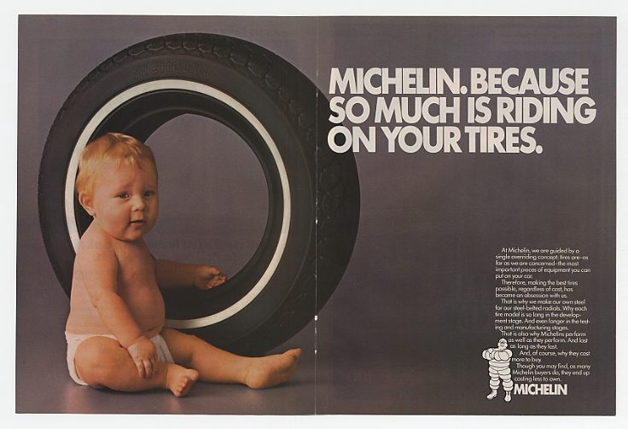
How is this advertisement trying to appeal to you?

Slide 15

… and this one?

Slide 16
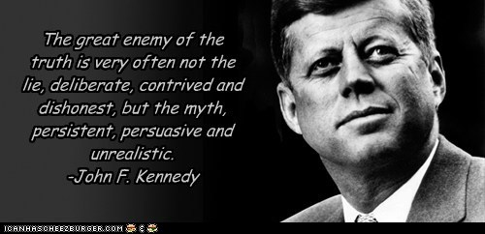
… and this one?

Slide 17
Appeals Application
Ad Assignment Guidelines:
--Create three separate ads for each different rhetorical appeal—Ethos, Pathos and Logos
--Do each different appeal on a separate slide in a powerpoint doc
--Following each ad you create and on a separate slide, do the accompanying appeal analysis questions (see slides 5, 8 and 11 of this ppt) for that distinctive appeal.

Slide 18
Getting Started …
To get started search for photos on google images
-- create an ad for each different appeal to try to sell something or promote a cause or idea
--Create your own text to reflect each individual appeal
--Your ads will be due to moodle before our next class

Slide 19
FYI:
Rhetorical Appeals are discussed in depth on the Purdue OWL website: http://owl.english.purdue.edu/owl/resource/588/04/

